Slide 1
Serverless Architecture

Slide 2

Hello!
I am Hassan Murtaza
DevOps/Cloud Engineer @ OneByte
You can find me at
Writes @ hassanmurtaza.com
OpenSource @ github.com/MrHassanMurtaza

Slide 3
What’s the Agenda
Journey to Serverless
What is Serverless
Why Serverless
Serverless in Production
Serverless Frameworks
Demo

Slide 4
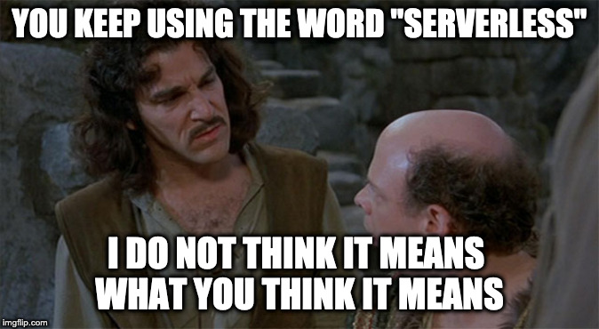

Slide 5
How we got here?
On Premise

Slide 6
How we got here?
On Premise
Cloud & Virtualization

Slide 7
How we got here?
Infrastructure as a service (IAAS)
On Premise
Cloud & Virtualization

Slide 8
How we got here?
Infrastructure as a service (IAAS)
On Premise
Cloud & Virtualization
Platform as a service (PAAS)

Slide 9
How we got here?
Infrastructure as a service (IAAS)
Serverless (FAAS)
On Premise
Cloud & Virtualization
Platform as a service (PAAS)

Slide 10


Slide 11
What is Serverless
Why are we here today? What the heck is serverless?

Slide 12
In a nutshell, serverless is a cloud computing architecture that allows developers to build and run code without having to manage, provision, or monitor infrastructure.

Slide 13
Why Serverless
No Infrastructure Provisioning
No management of servers
Autoscaling / Load Balancing
Pay for Value
Highly Available and Secure
Multiple Runtimes
Quick release to production

Slide 14
Supports Multiple Runtimes
NodeJS
Python
GO
Ruby
C#
Java

Slide 15
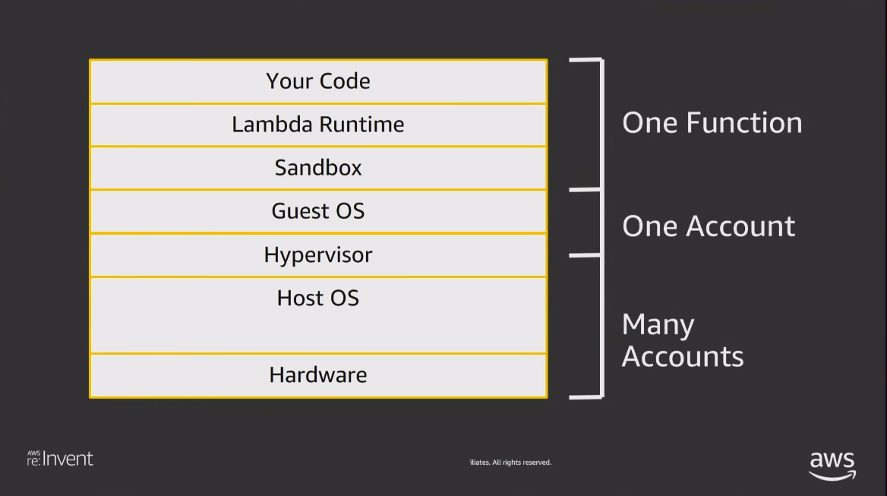

Slide 16


Slide 17
Serverless in Production
Possibilities are limitless but let’s discuss some common use cases.

Slide 18
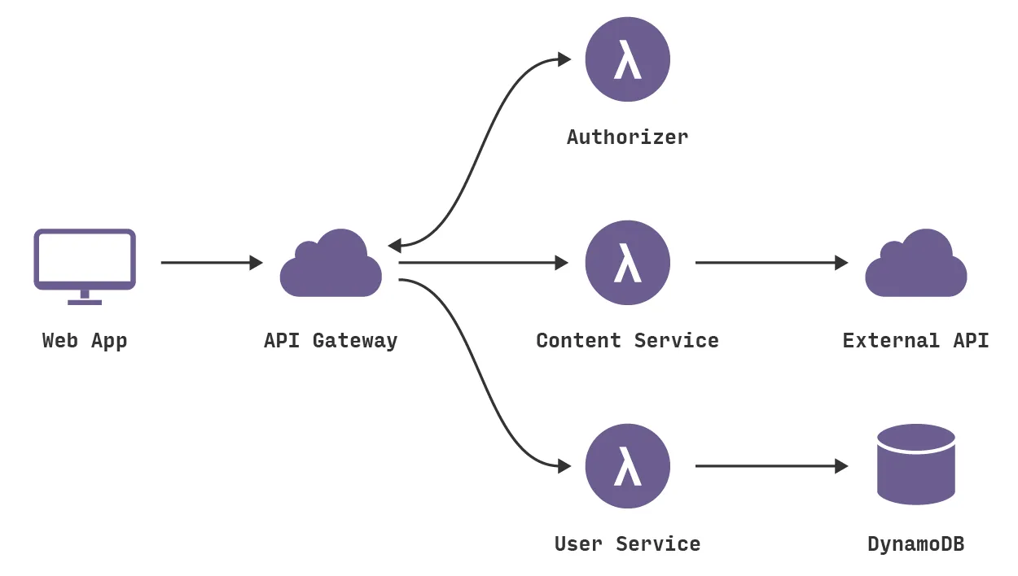
Simple Website with Backend Logic

Slide 19
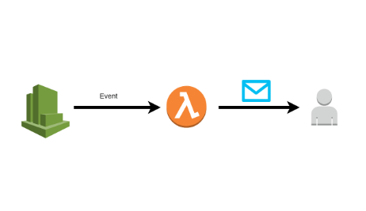
Automating Regular Jobs

Slide 20
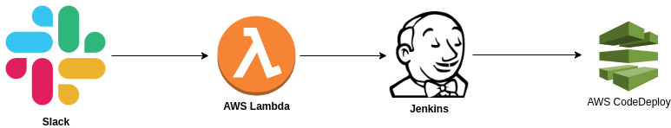
How we are using at OneByte

Slide 21
Serverless Frameworks
Zappa for Python
Serverless Framework Nodejs
Chalice
Serverless Application Model (SAM) by AWS

Slide 22


Slide 23
Enough Talk! Let’s Demo;

Slide 24
Demo on AWS Console

Slide 25
Demo using Serverless Framework Offline

Slide 26
Demo using Serverless Framework

Slide 27
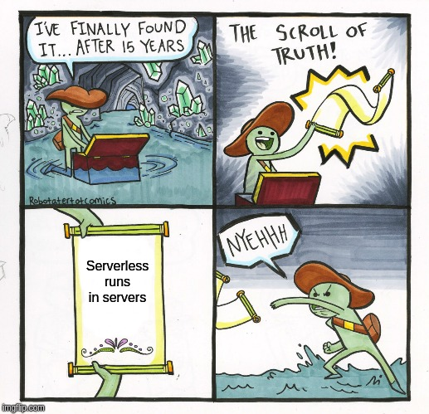

Slide 28
Thanks!
Any questions?
You can find me at hassanmurtaza.com or
email me at mrhassanmurtaza@gmail.com

